Slide 1

Home Electrical Management and Security System
SERGE YVON NGUEKO TCHAMANDE

Slide 2
Why Chose This Project?
This project introduces a comprehensive "Home Electrical Management and Security System." As technology continues to shape our lives, the integration of smart solutions for efficient electrical management and enhanced security becomes increasingly vital.
The decision to embark on this project stems from a recognition of the growing significance of home automation. By developing a system that combines electrical management with robust security features, we aim to address real-world challenges and contribute to the evolution of smart home solutions.

Slide 3
Project Objectives
Electrical Management
Efficiently monitor and manage home electrical consumption, promoting energy conservation and cost efficiency.
Intrusion Detection
Implement a reliable intrusion detection system using advanced sensors to enhance home security.
Real-time Notification
Establish a real-time notification mechanism, ensuring prompt alerts for any detected intrusions or critical electrical events.

Slide 4
Hardware Components, Technologies Employed
Utilized components include Ultrasonic Sensor, ChainableLED, Particle ARGON, and more, forming the backbone of the system
Leveraged technologies such as Particle Cloud and ThingSpeak to enable seamless connectivity and data management.

Slide 5
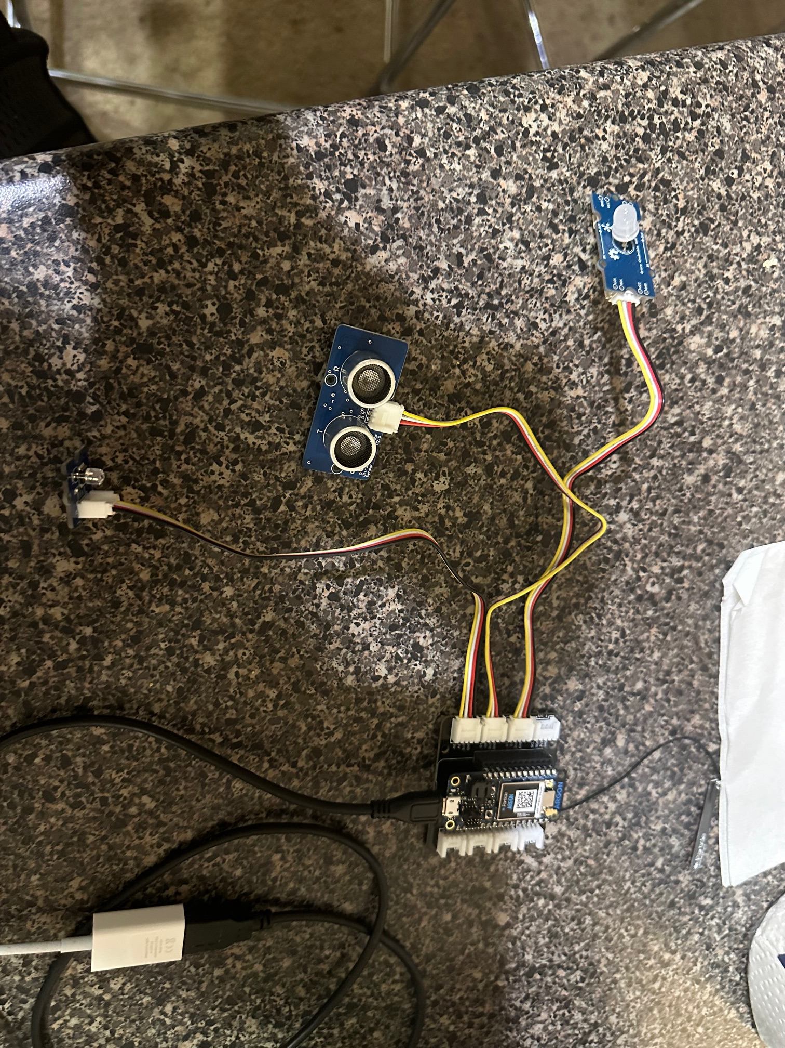

Slide 6
Project Architecture
A detailed diagram illustrating the interplay between various components within the system.
Visual representation of how sensors are intricately connected to the Particle Photon for efficient data processing.

Slide 7
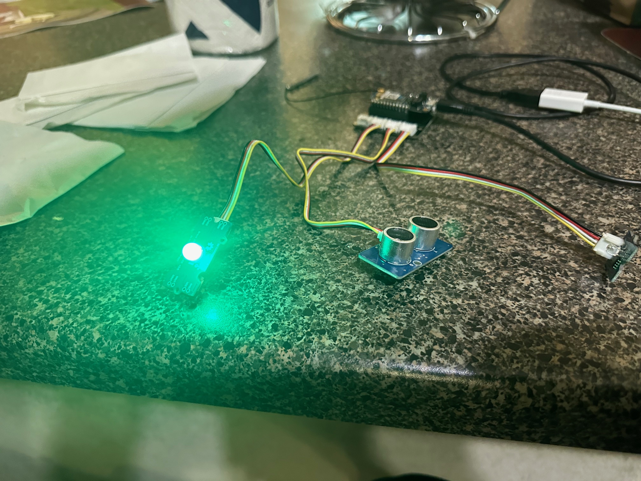

Slide 8
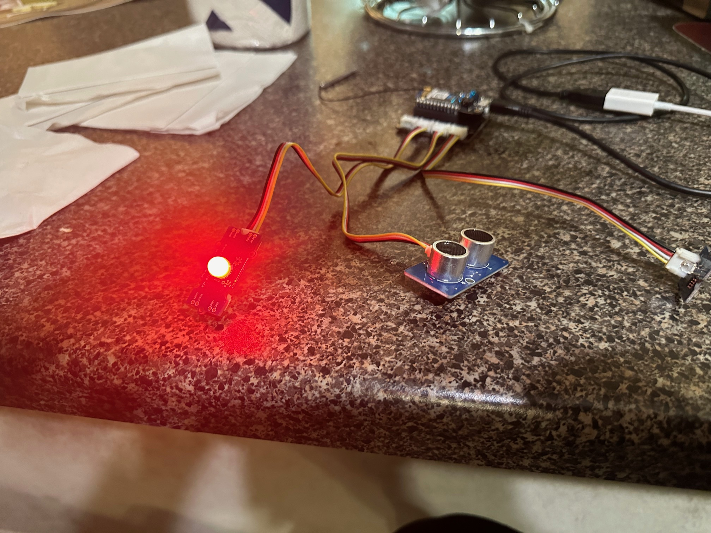

Slide 9
Practical Perspectives
Exploration of how the project can enhance daily life.
Real-world scenarios demonstrating practical usage.
Potential benefits for home security and energy efficiency.

Slide 10
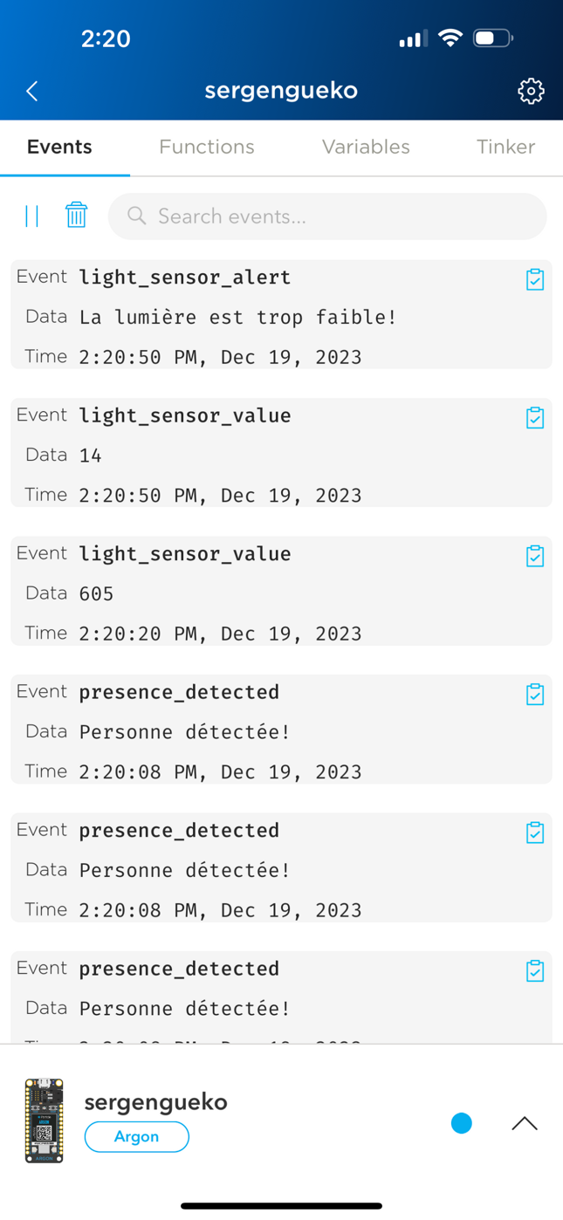

Slide 11
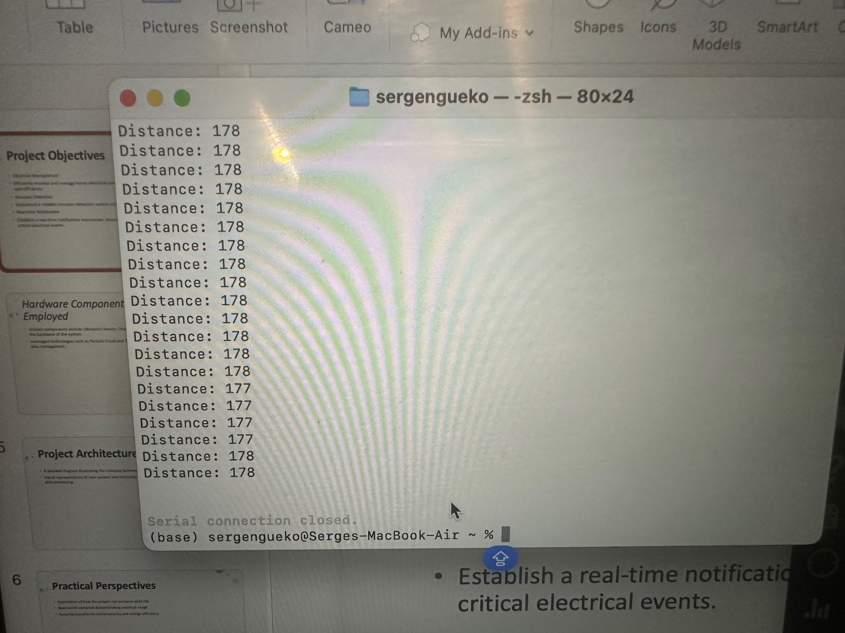

Slide 12
Future Adaptations
Let's now explore the future developments of our project. We have identified several avenues for expanding functionality and improving performance.
Integration of New Sensors and Features: To enhance the sensor array, we could consider incorporating gas sensors, air quality sensors, or even surveillance cameras for more precise and versatile detection. These additions could not only bolster security but also broaden the scope of intelligent home environment management.
Improvements Based on User Feedback: User feedback and daily experiences will steer our future enhancements. We could fine-tune detection thresholds, adjust electrical management algorithms based on consumption habits, and integrate intelligent features derived from observed behaviors.
Examples from Related Platforms: Let's draw inspiration from successful similar platforms. Features like integration with voice assistants such as Amazon Alexa or Google Assistant, IoT connectivity with other smart devices in the home, and even compatibility with mobile applications for remote control are examples of adaptations that could enhance the appeal and utility of our system in daily life.
Considering these perspectives, our project evolves into a scalable platform, capable of adapting to changing needs and embracing future innovations for an even more enriching user experience.

Slide 13
Challenges Faced
During the development process, several challenges emerged, each providing an opportunity for learning and continuous improvement.
Limited Particle Capacity: One major challenge encountered was the limited capacity of the Particle platform to seamlessly handle data-intensive sensors. This necessitated a strategic approach in resource management to avoid potential performance issues. We optimized the sensor reading frequency and adjusted how data was processed to ensure efficient use of limited resources.
Arduino Failure and Project Adaptation: An unexpected Arduino failure interrupted the initial development. This experience prompted a reevaluation of our approach and a redesign of the project for increased reliability. We strengthened redundancy mechanisms and implemented backup practices to minimize the impact of potential hardware failures in the future.
Particle Library Limitations: Another challenge arose from the Particle library, which proved insufficient to support all required sensor types. To overcome this limitation, we explored alternative solutions, implemented custom libraries when necessary, and contributed to the community by sharing our enhancements.
Lessons Learned: These challenges taught us the importance of flexibility in design, the need to anticipate platform limitations, and the significance of robustness in the face of unforeseen failures. These experiences also bolstered our ability to solve complex problems and iterate rapidly in a constantly evolving environment. Ultimately, these challenges shaped a more robust project and equipped us with valuable skills for addressing similar projects in the future.

